Slide 1
AIMS OF THE CAPACITY BUILDING WORKSHOP
To discuss the land issues that mobile indigenous peoples face in their countries
To examine legal mechanisms relating to land issues of mobile indigenous peoples
To review how these specific land issues can be address using the legal mechanisms discussed
Using the group as advisors, prepare a plan of the strategies required to address these land issues legally

Slide 2
Rich Picture
A Rich Picture is used to develop a comprehensive, visual understanding of complex systems
Rich Pictures provide a way of presenting the situation as a whole, from which you can see the situation at a glance

Slide 3
Rich Picture Exercise
You will draw, on a flipchart paper, a picture of the land issues or problems in your environment
It is a way of illustrating in a drawing, land issues that you and your organisation/group are facing, which can be easily shared within the larger group during discussion

Slide 4
Rich Picture
You will also, with your group, talk about strategies, using the legal frameworks introduced just now by Jeremie

Slide 5
Rich Picture
When creating your rich picture, include information about:
Land issues and problems
Key stakeholders and relationships
Legal tools
Position yourself in this picture, and put in politics, and all factors that influence the land issues

Slide 6
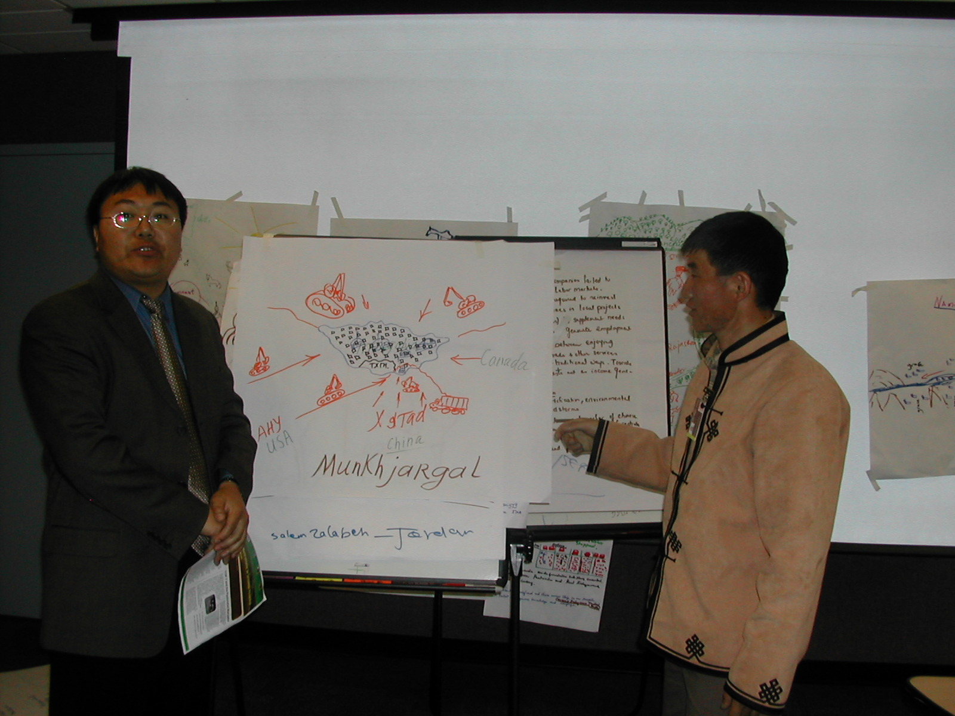

Slide 7
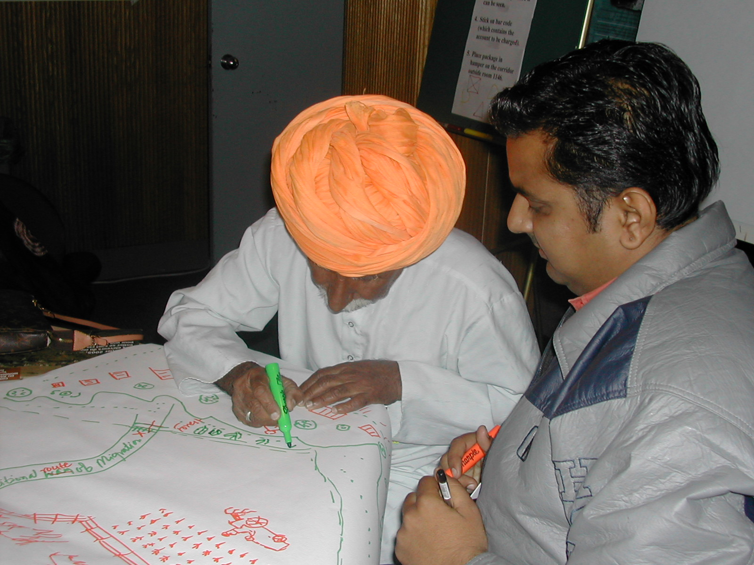

Slide 8
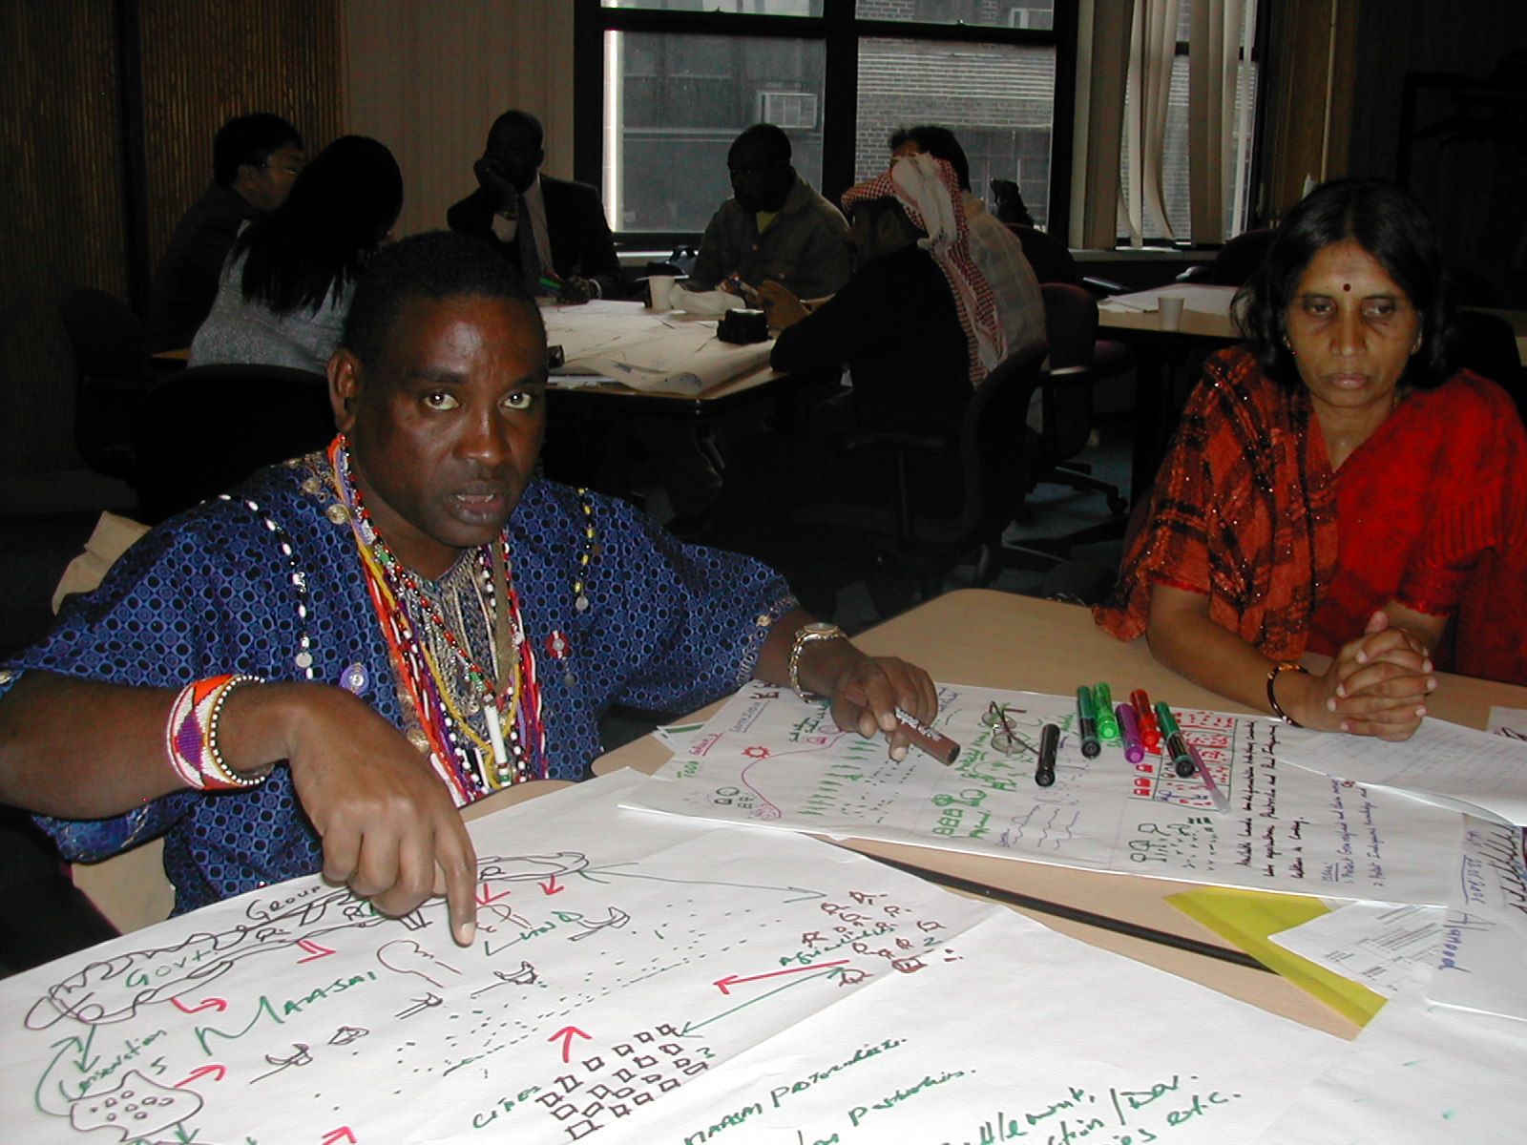

Slide 9
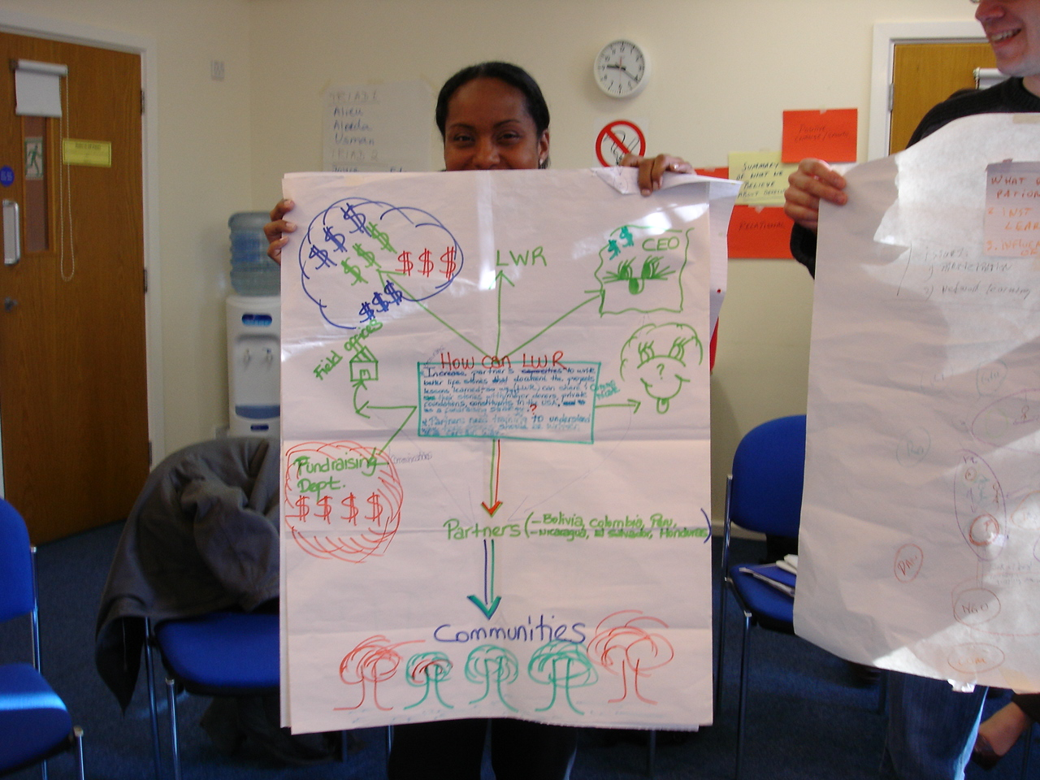
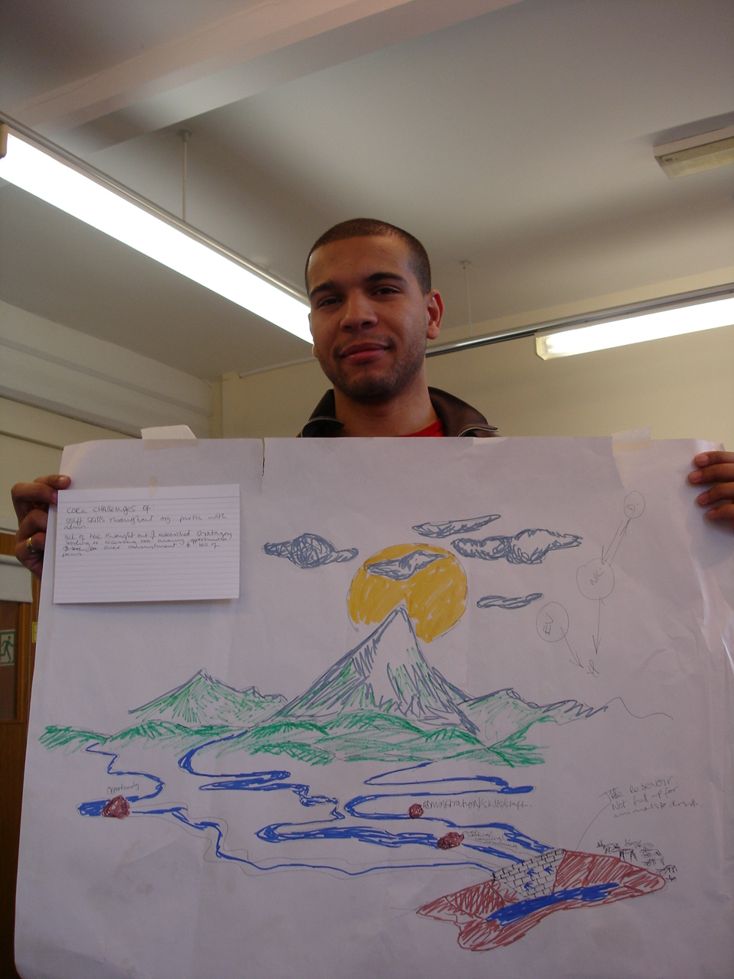
Rich Picture

